Slide 1
DATA 612 - Recommender Systems in Context
Zach Alexander
June 30th, 2020

Slide 2



Online grocery shopping and delivery
Demand continues to increase year-over-year
22% increase in 2019
40% increase in 2020 (as of May of this year)¹
*seeing spikes due to COVID-19
¹https://www.supermarketnews.com/online-retail/online-grocery-sales-grow-40-2020

Slide 3
Grocery ordering and delivery service
Order groceries online from your favorite stores
Have a shopper shop for you
Have your groceries delivered to your door
Claimed more than half of the online-grocery market in April of this year
¹https://www.grocerydive.com/news/instacart-claims-more-than-half-of-online-grocery-market/579509/

Slide 4
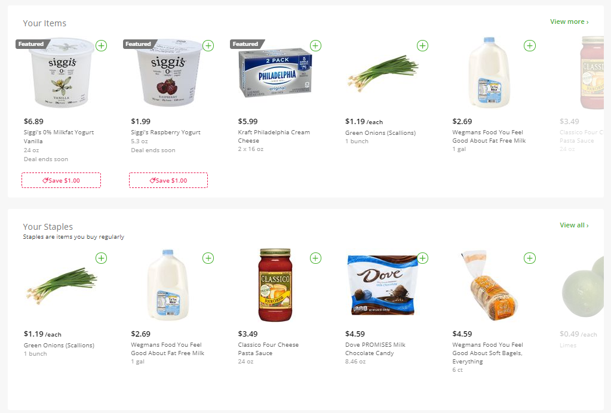
Entire structure and ideology of the company is embedded in data science
Multiple models running simultaneously in production

Slide 5
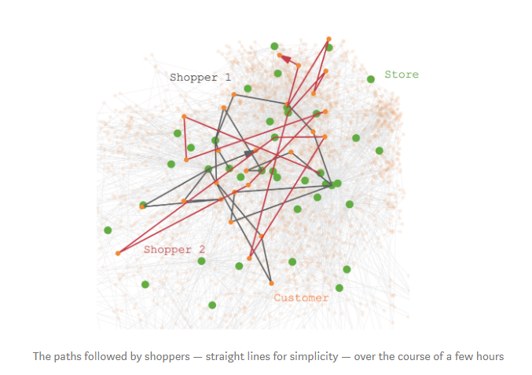
Just a few of the algorithms in use
“Fulfillment algorithm” - routing shoppers to store locations to pick groceries and deliver them to customers’ doorsteps
Optimizing the speed of the shopper
How busy the store is at the current moment
Routing shoppers to be able to fulfill multiple orders
Timeliness
https://tech.instacart.com/it-all-depends-4bb7b22e854b

Slide 6
Just a few of the algorithms in use (cont.)
Shopping experience algorithms
“Buy It Again” functionality
Recommended items to buy based on past shopping history
Product “bundles” -- i.e., because a user buys chips, they’ll likely buy salsa
Shopper experience algorithms
Sorting the user list in an optimized way to save the shopper time in the store

Slide 7
A potential way to recommend food
How could we recommend certain food items to customers that they haven’t purchased before?
In 2017, Instacart created a Kaggle challenge and made 3 million of their orders (anonymized) available for data science exploration
One approach: Use unsupervised learning with k-means clustering
K-means clustering for customer segmentation
Would need to find the optimal number of clusters

Slide 8
Potential features for k-means clustering
Features based on user activity and habits:
Which day(s) of the week do customers shop for food?
Which hour(s)?
How many days has it been since their last order?
What is the number of total orders placed
How many total products are purchased in past orders
Develop features based on similarity in product names:
Use something like Word2Vec (NLP technique) to map the product names to a vector space

Slide 9
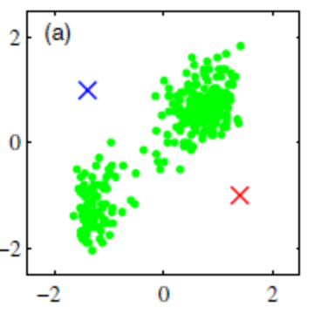
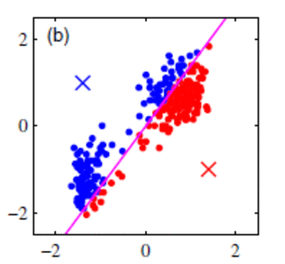
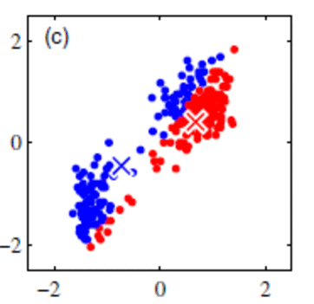
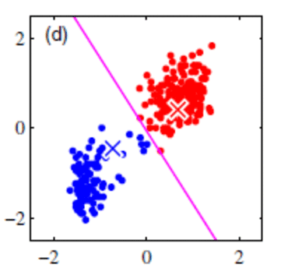
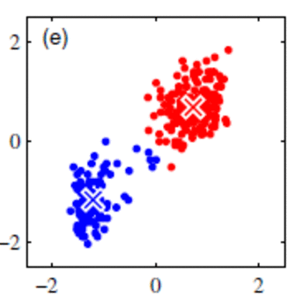
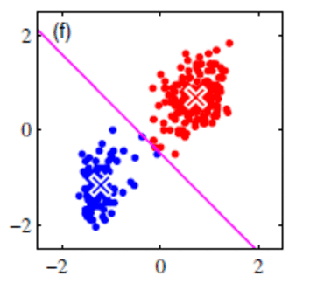
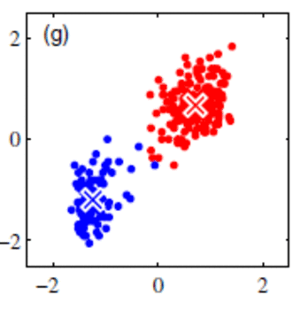
K-means clustering
https://towardsdatascience.com/k-means-clustering-8e1e64c1561c

Slide 10
Obtain most popular products in each cluster
Once customers are clustered into groups, we can see which products are most popular among the groups.
For products that haven’t been bought by a customer, these could be recommended items to purchase.

Slide 11
Food recommendations are very complex
Although an approach like this may yield some meaningful recommendations, there are many things that need to be considered:
Some products (such as staples and canned foods), are bought less frequently than items like produce and dairy products -- which hold higher weights in recommendations?
Keeping up with store inventories and pricing is a huge strain
Specificity of food types is tricky
You wouldn’t want to recommend beef sausages to someone who’s vegetarian/vegan
Should we recommend pickled carrots? Pickles? Carrots?

Slide 12
A whole new appreciation for these services
In the end, companies such as Instacart are exploring a new frontier in how humans gain access to food
These systems are complex, and are something I’ll appreciate more the next time I place my Instacart order and notice that they’ve recommended my favorite ice cream flavor

Slide 13
Sources
https://en.wikipedia.org/wiki/K-means_clustering
http://ceur-ws.org/Vol-1533/paper5.pdf
https://ai.intelligentonlinetools.com/ml/k-means-clustering-example-word2vec/
https://towardsdatascience.com/k-means-clustering-8e1e64c1561c
https://arxiv.org/pdf/1301.3781.pdf
https://tech.instacart.com/the-story-behind-an-instacart-order-part-1-building-a-digital-catalog-46df5a8ff705
https://tech.instacart.com/it-all-depends-4bb7b22e854b
Instacart Anonymized Dataset
https://www.kaggle.com/c/instacart-market-basket-analysis

